Slide 1
Unfolding the AmBe Neutron Spectra using GRAVEL and MLEM
Tyler D. Doležal, First Lieutenant
Air Force Institute of Technology
Department of Engineering Physics

Slide 2
Overview
Time of Flight Experiment
Gamma and AmBe Data Collection
Neutron Unfolding Algorithms
GRAVEL
MLEM

Slide 3



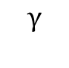
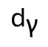
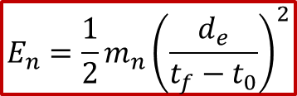
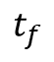
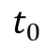
Time of Flight Experiment
AmBe
d_{n}
Stop
n
$${\text{d}}_{\text{γ}}$$
$$α+{}_{4}^{9}Be→{}_{6}^{13}{C^{∗}}→{}_{6}^{12}C+n+γ(4.44 MeV)$$
$$t_{f}$$
$$γ$$
Start
(2x) 2” EJ-309 w/ 2” PMT
AmBe neutron energy spectrum
Compare to unfolded results
Use as a priori initial guess
$$E_{n}=\frac{1}{2}m_{n}{\left(\frac{d_{e}}{t_{f}−t_{0}}\right)}^{2}$$
$$t_{0}$$

Slide 4
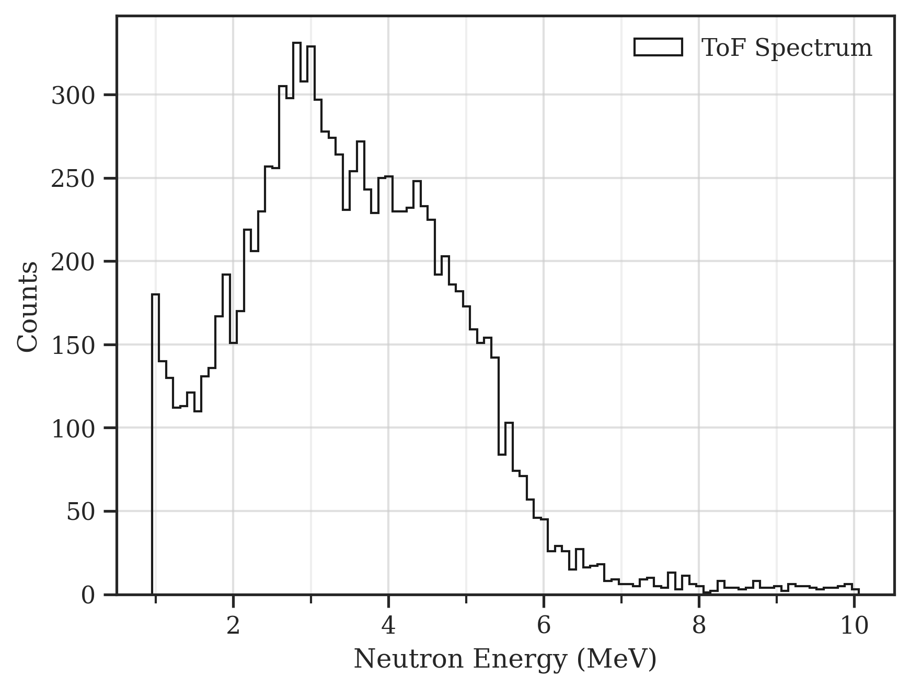
Time of Flight Experiment

Slide 5
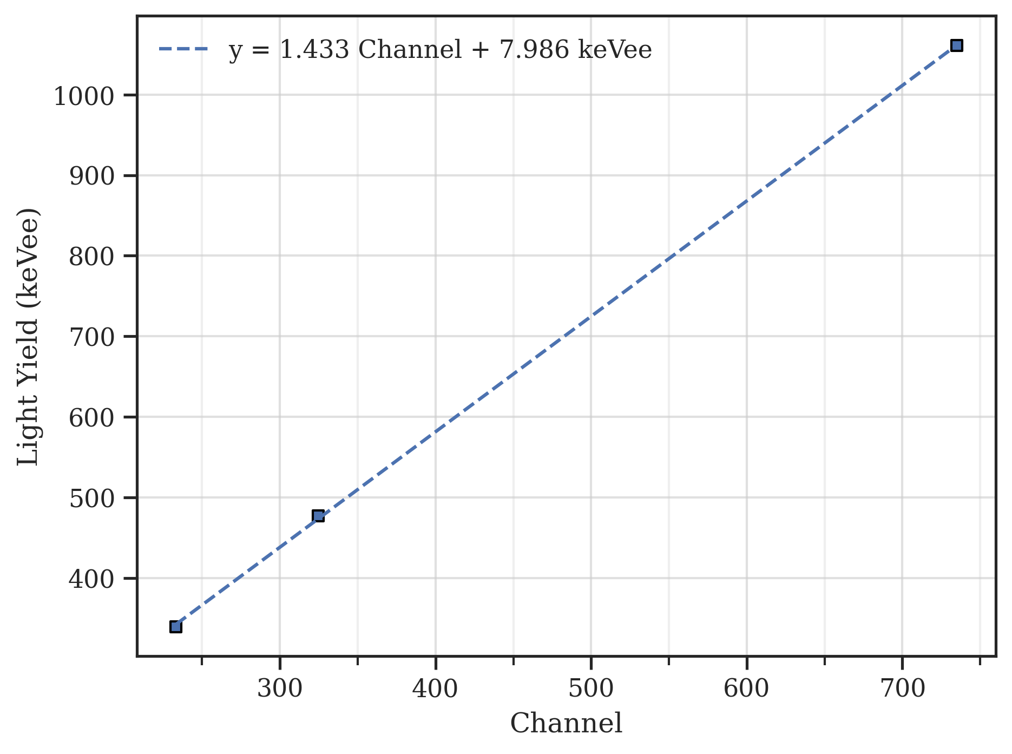
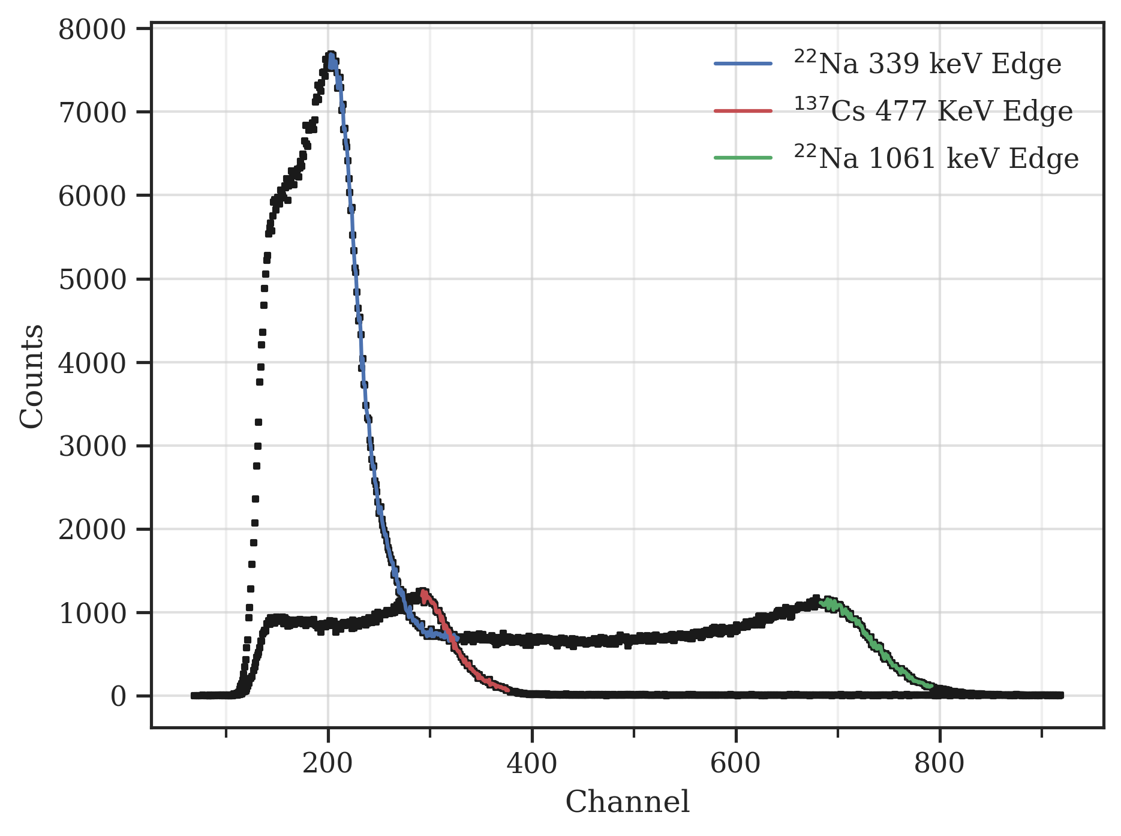
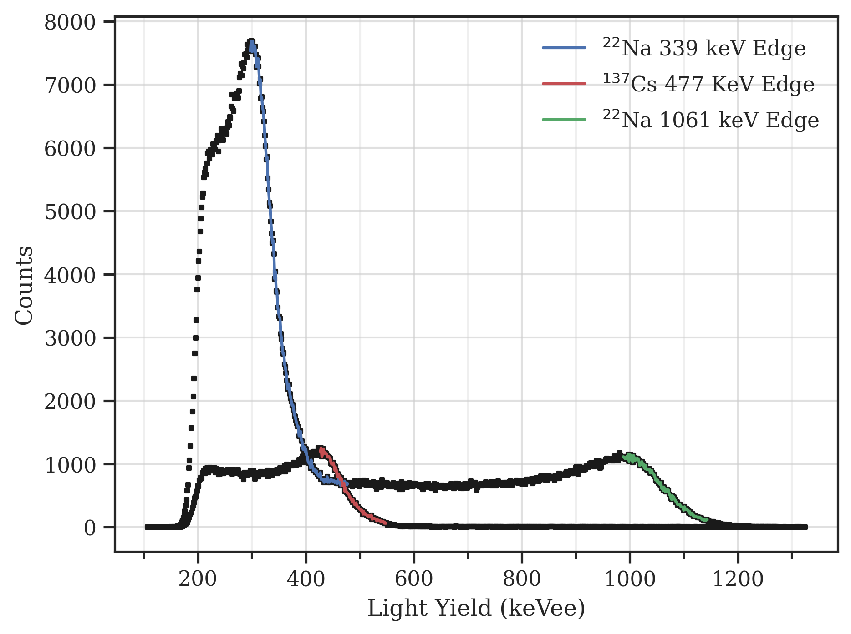

Gamma Data
2” EJ-309 detector w/ 2” PMT
Na-22 and Cs-137 Compton Edges used as calibration points
$${\text{Q}}_{\text{long}}\text{ = }\text{m} \text{×} {\text{Q}}_{\text{long}} \text{+ }\text{b}$$
Pulse height must be calibrated for unfolding algorithm

Slide 6
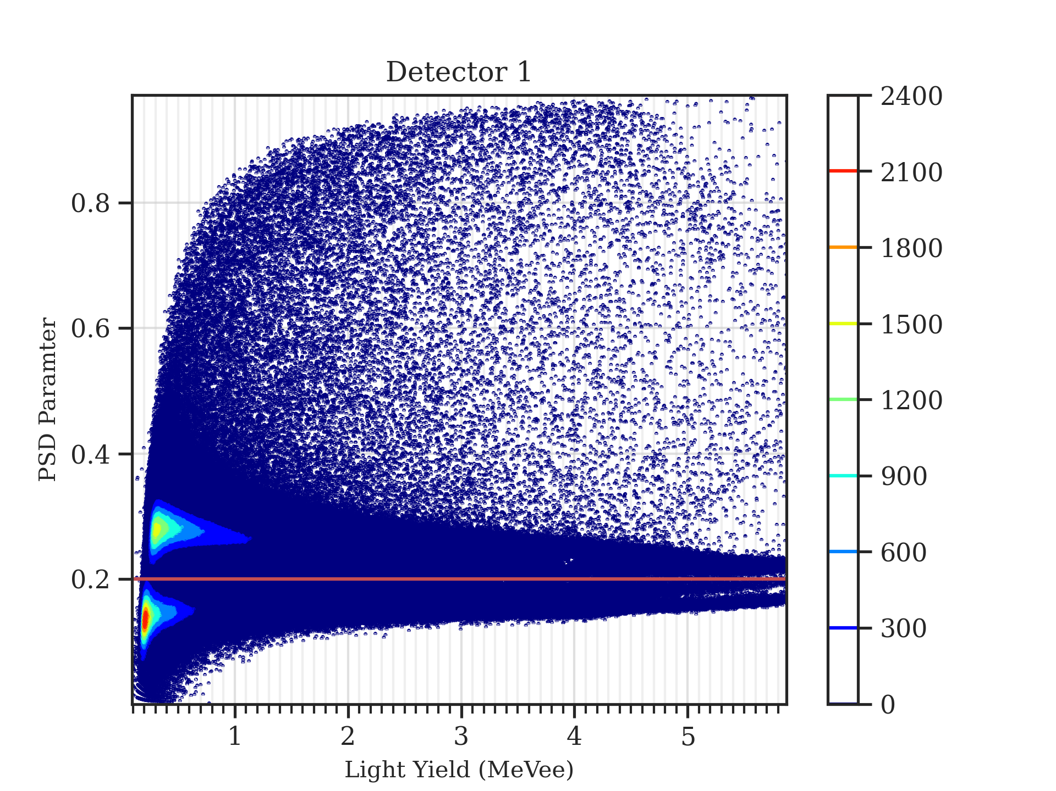
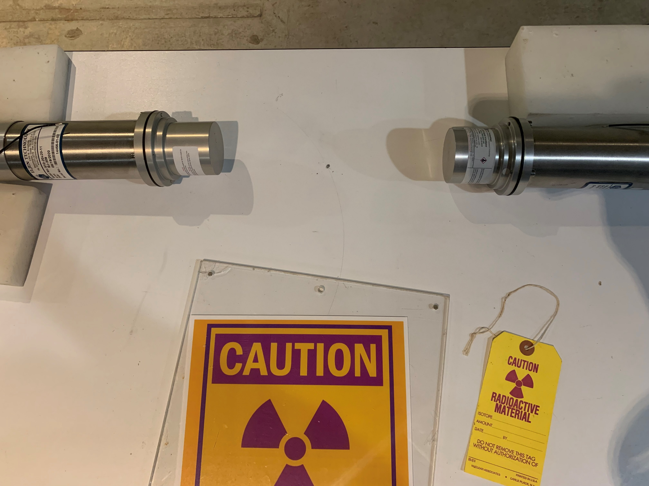
AmBe Data Collection
2” EJ-309 detector w/ 2” PMT
90-hour collection time
source

Slide 7
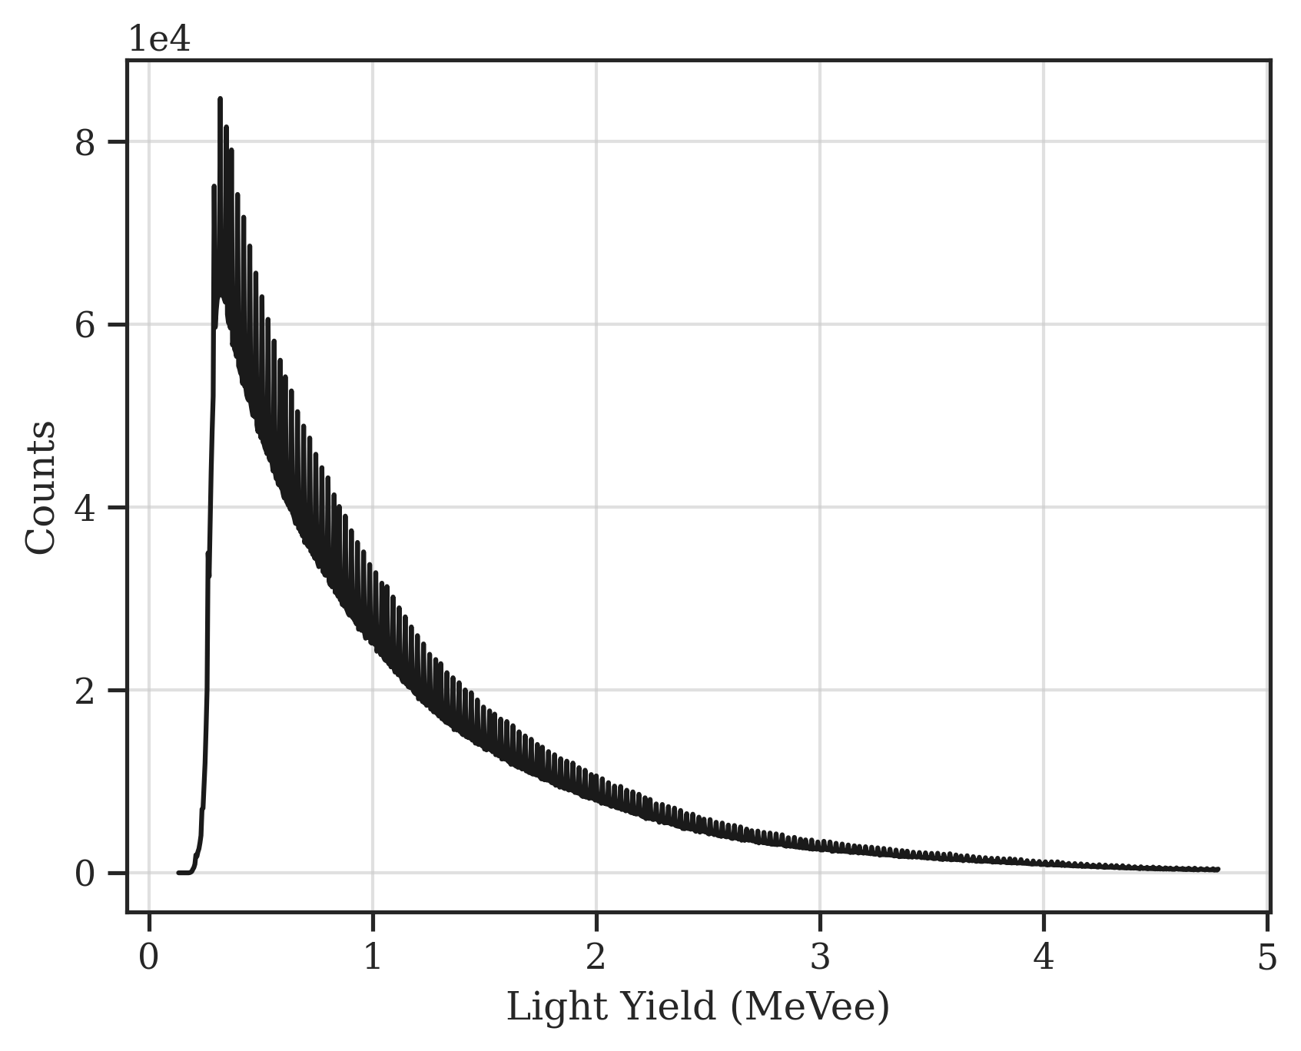
AmBe Data Post-Process
Neutron-only signal

Slide 8
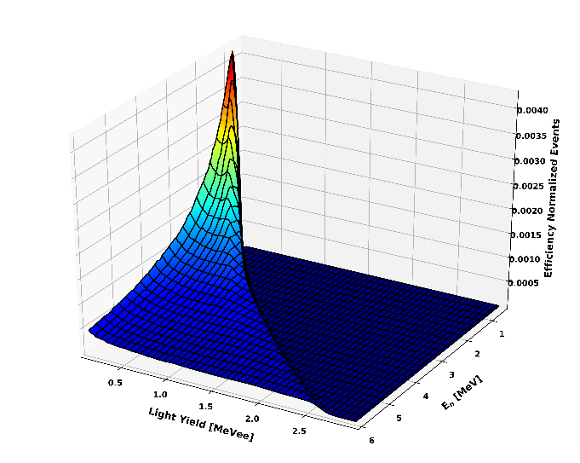
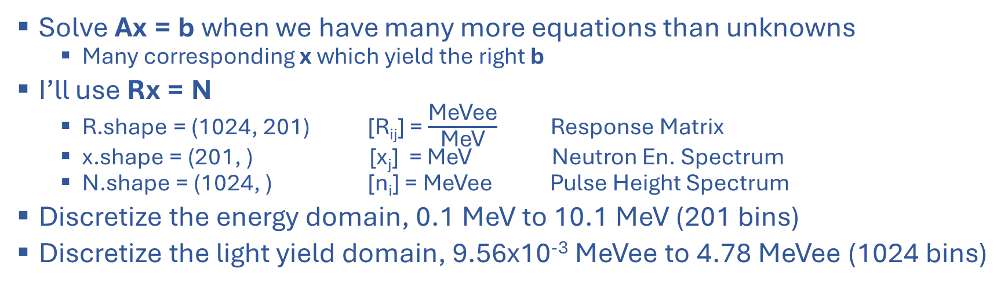
Neutron Unfolding, Introduction
Solve Ax = b when we have many more equations than unknowns
Many corresponding x which yield the right b
I’ll use Rx = N
R.shape = (1024, 201) [R_{ij}] = $\frac{\text{MeVee}}{\text{MeV}}$ Response Matrix
x.shape = (201, ) [x_{j}] = MeV Neutron En. Spectrum
N.shape = (1024, ) [n_{i}] = MeVee Pulse Height Spectrum
Discretize the energy domain, 0.1 MeV to 10.1 MeV (201 bins)
Discretize the light yield domain, 9.56x10⁻³ MeVee to 4.78 MeVee (1024 bins)
R
x
N
=

Slide 9
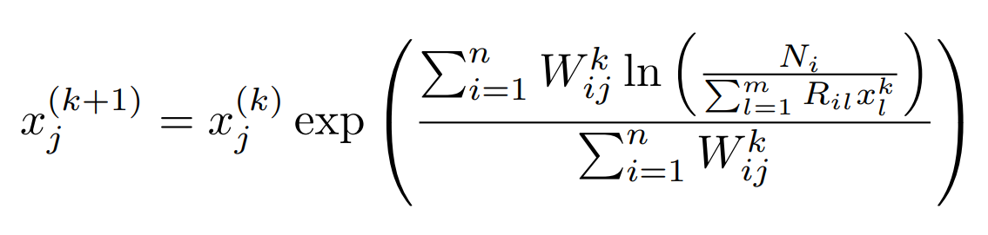
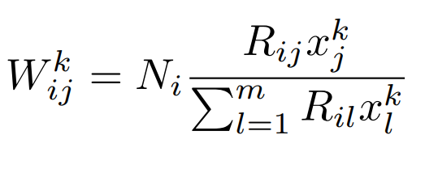
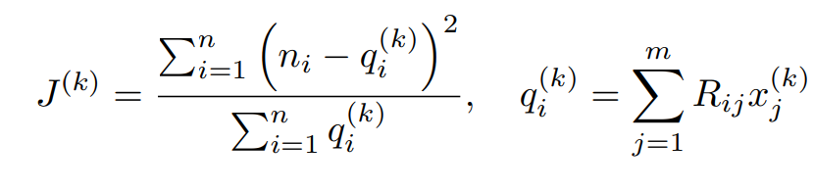
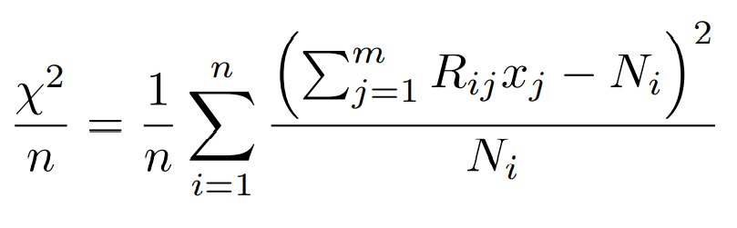
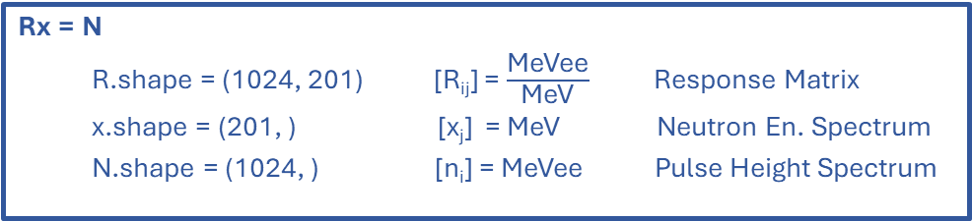
Neutron Unfolding, GRAVEL
Rx = N
R.shape = (1024, 201) [R_{ij}] = $\frac{\text{MeVee}}{\text{MeV}}$ Response Matrix
x.shape = (201, ) [x_{j}] = MeV Neutron En. Spectrum
N.shape = (1024, ) [n_{i}] = MeVee Pulse Height Spectrum

Slide 10
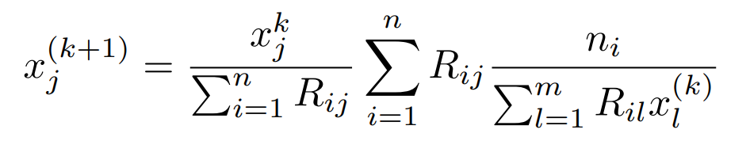
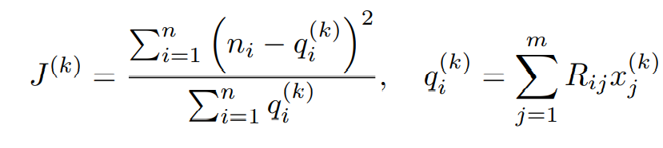
Neutron Unfolding, MLEM
Rx = N
R.shape = (1024, 201) [R_{ij}] = $\frac{\text{MeVee}}{\text{MeV}}$ Response Matrix
x.shape = (201, ) [x_{j}] = MeV Neutron En. Spectrum
N.shape = (1024, ) [n_{i}] = MeVee Pulse Height Spectrum

Slide 11
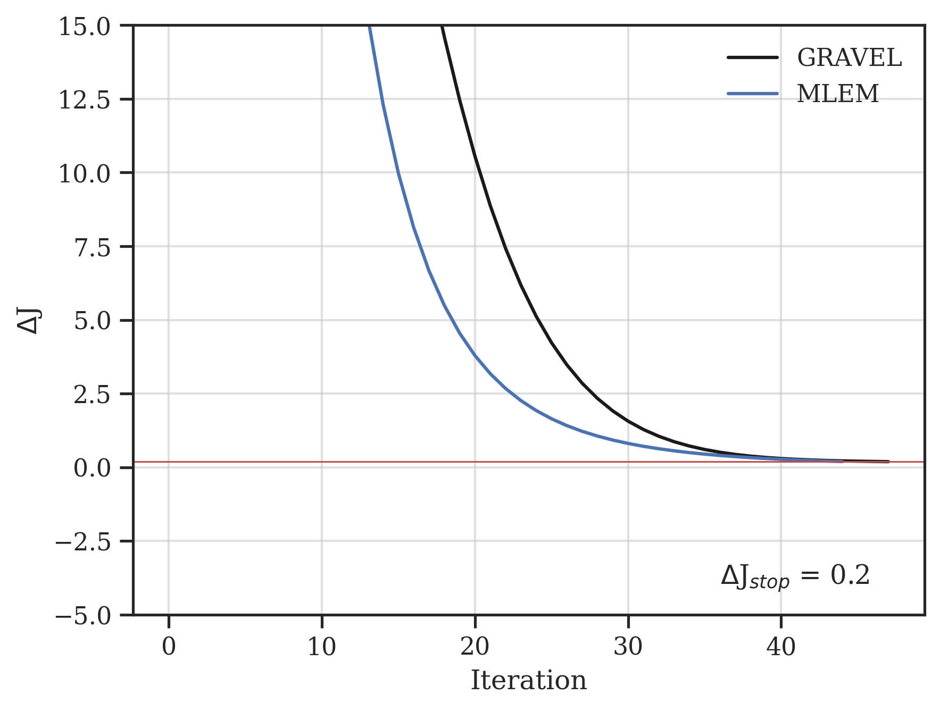
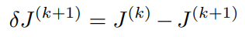
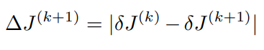
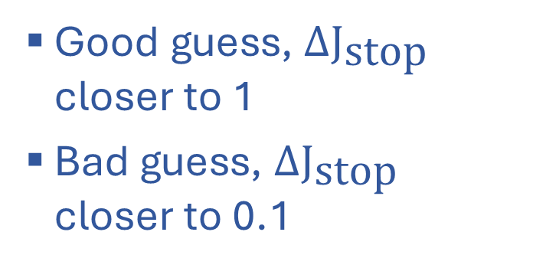
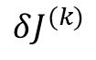
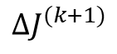
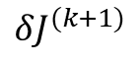
Neutron Unfolding, when do we stop?
$$δJ^{(k)}$$
$$ΔJ^{(k+1)}$$
J
$$δJ^{(k+1)}$$
Good guess, $\text{Δ}{\text{J}}_{\text{stop}}$ closer to 1
Bad guess, $\text{Δ}{\text{J}}_{\text{stop}}$ closer to 0.1

Slide 12
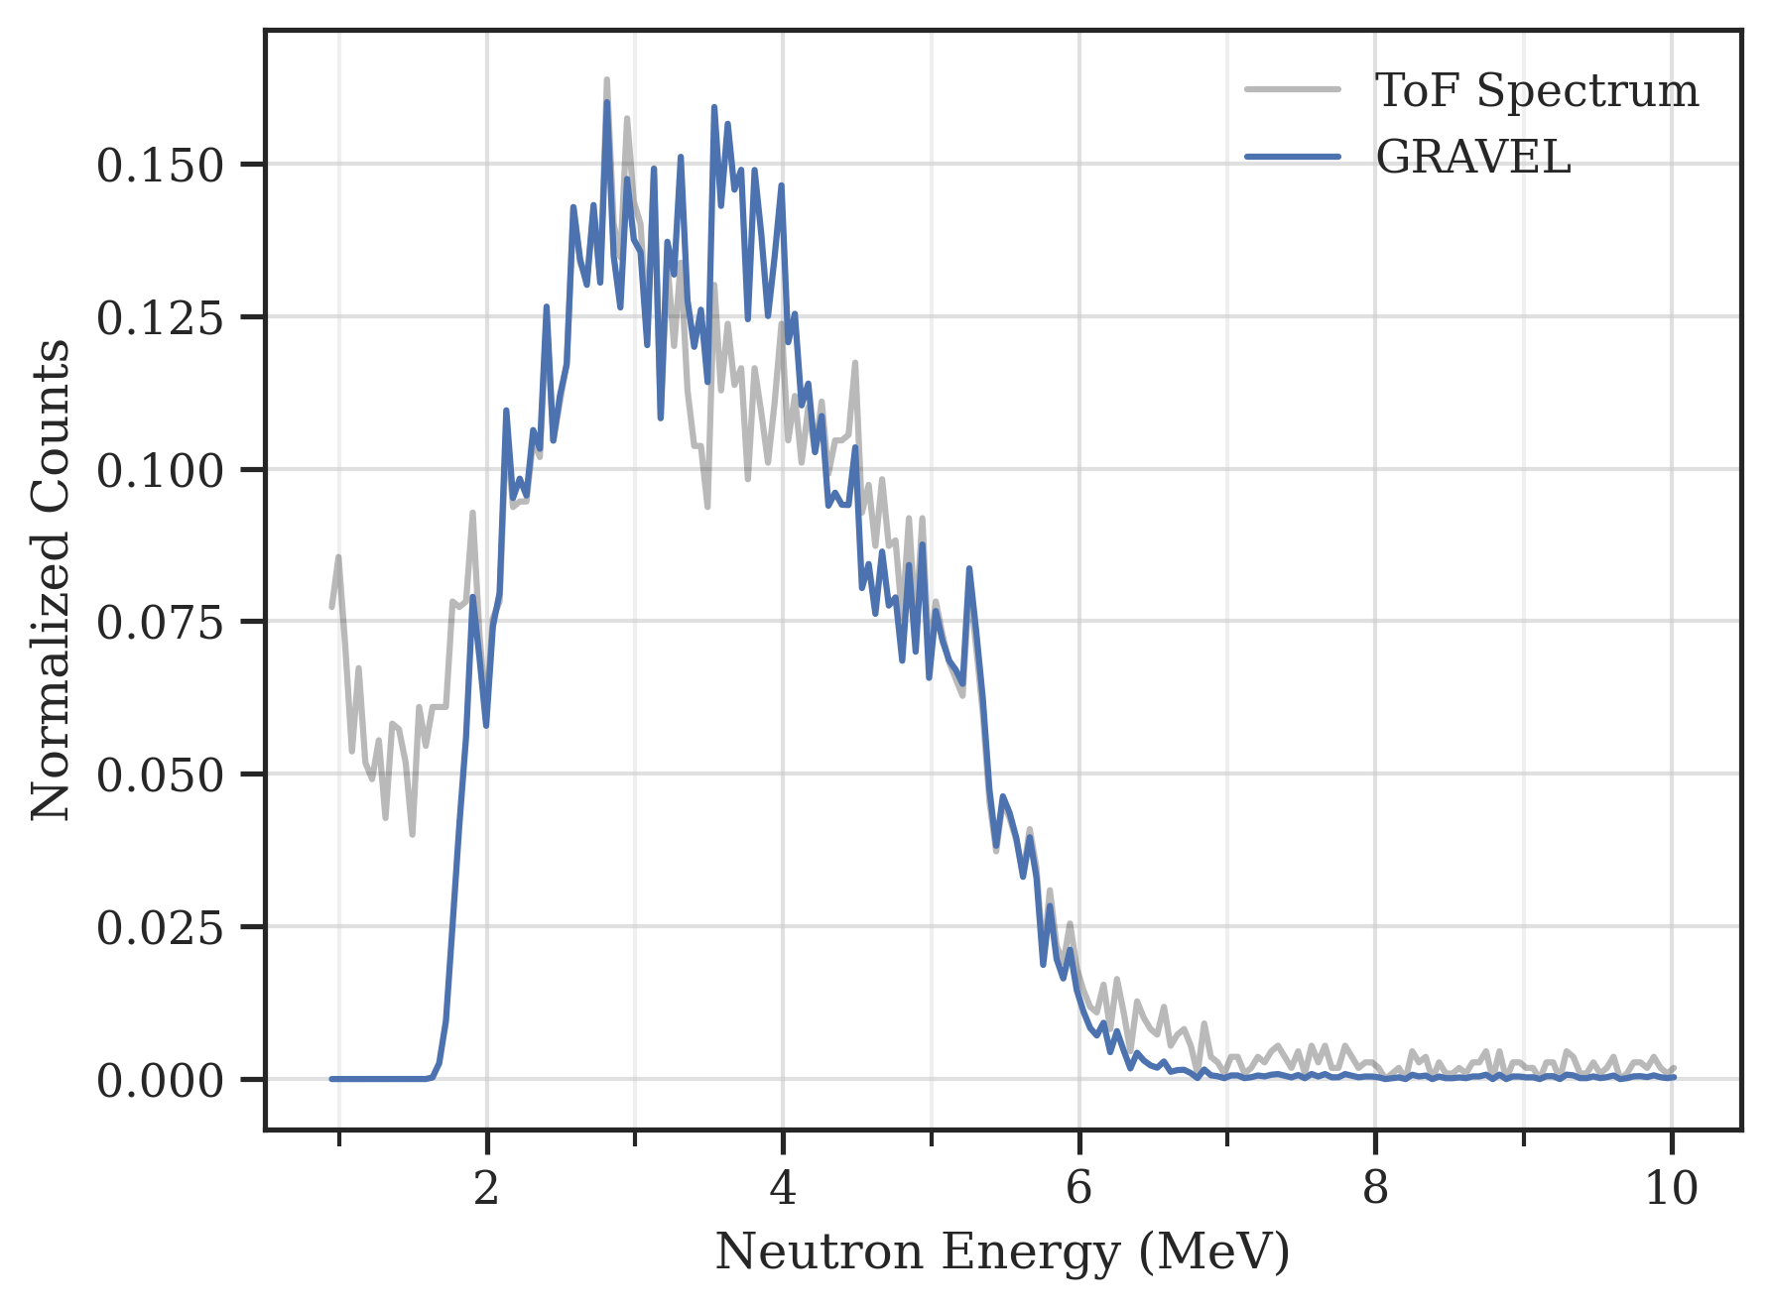
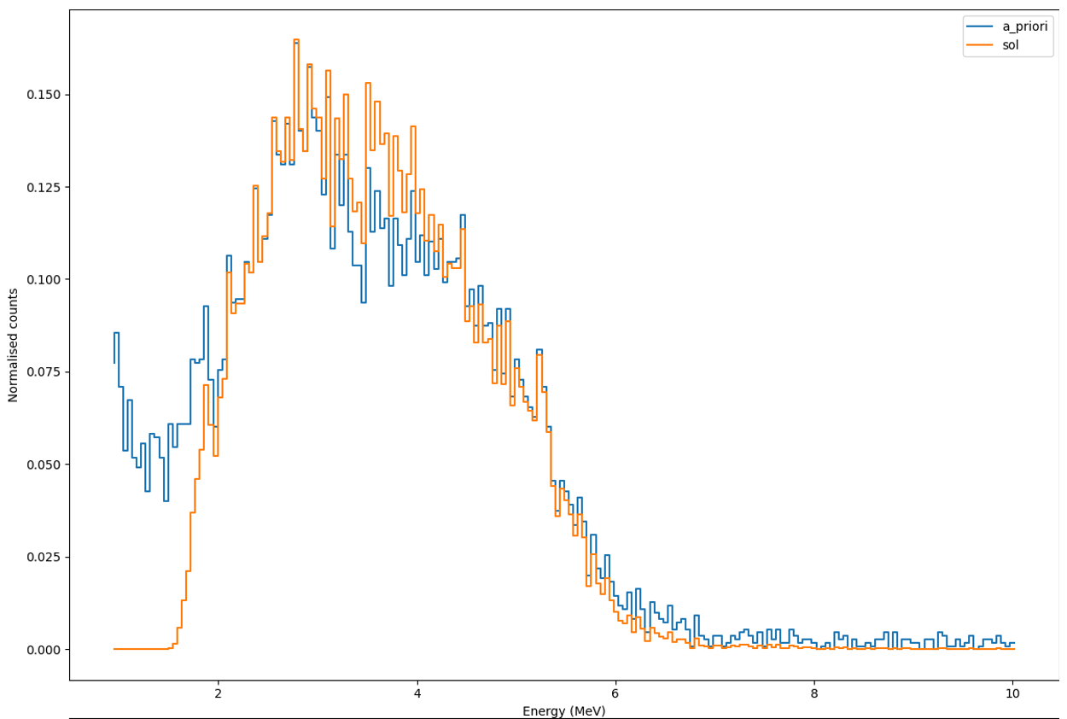
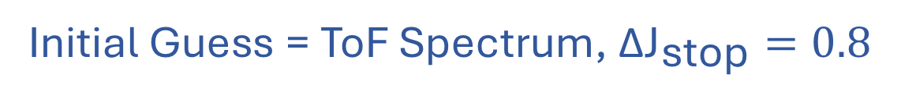
Neutron Unfolding, GRAVEL Results
Initial Guess = ToF Spectrum, $\text{Δ}{\text{J}}_{\text{stop}}=0.8$
1.
2.
Ran for 33 iterations
Ran for 20 iterations
The development, testing and comparison of unfolding methods in SPECTRA-UF for neutron spectrometry – ScienceDirect (2020)

Slide 13
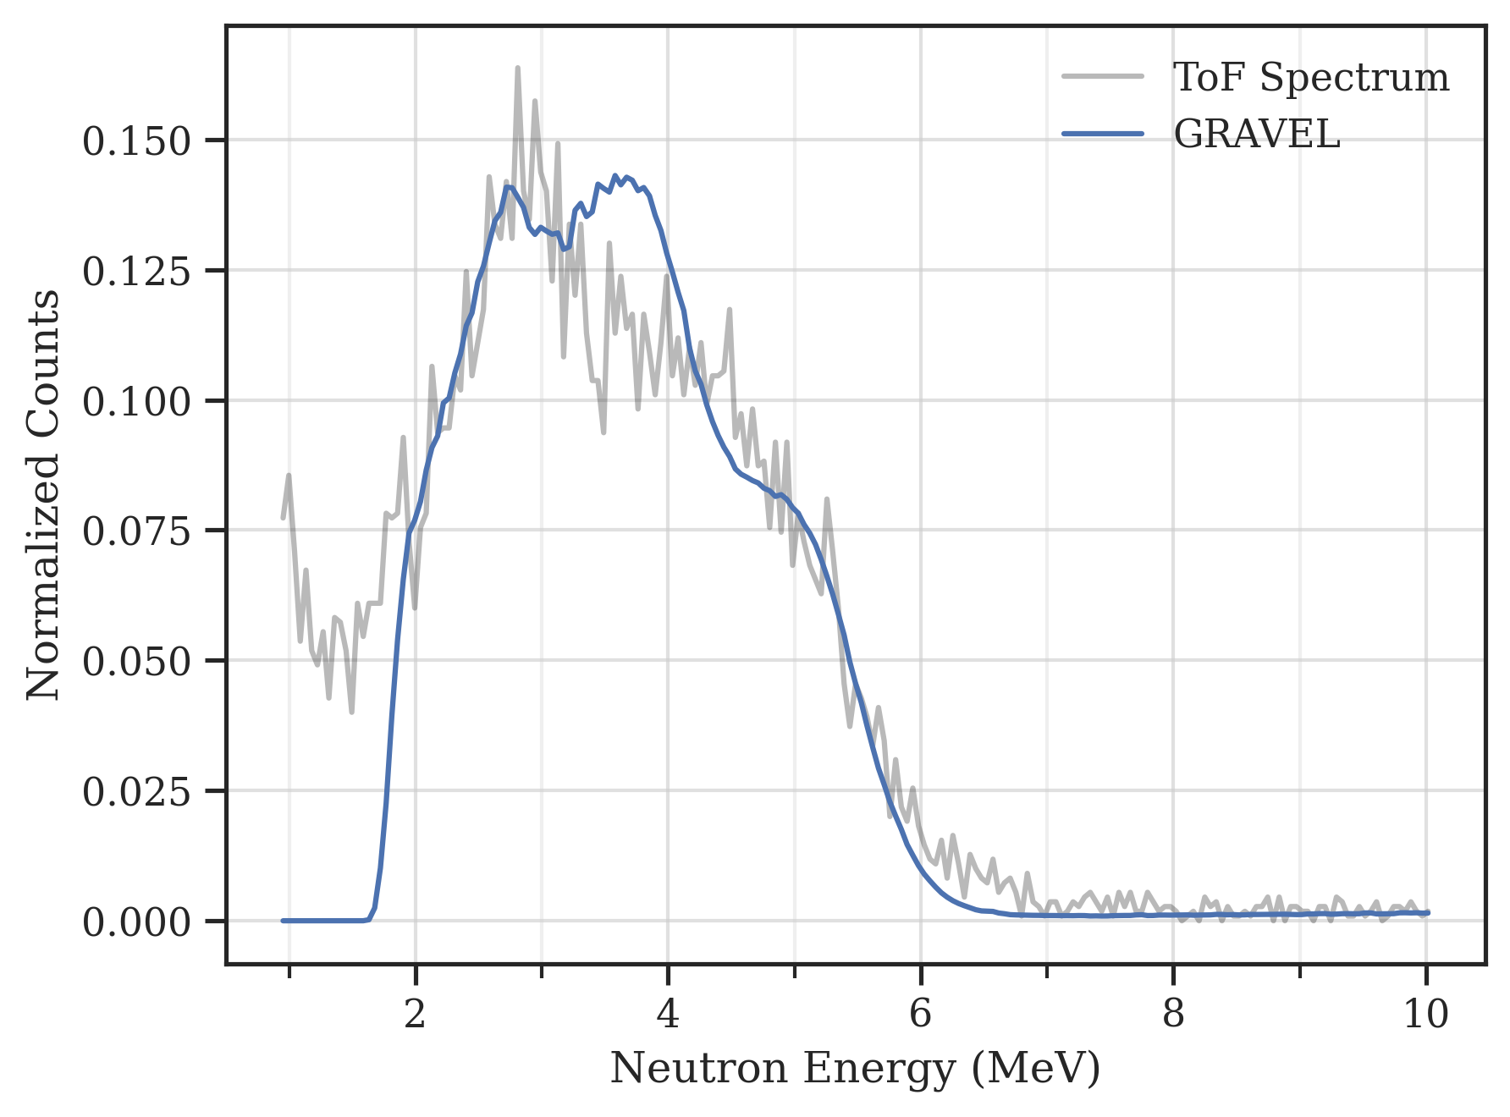
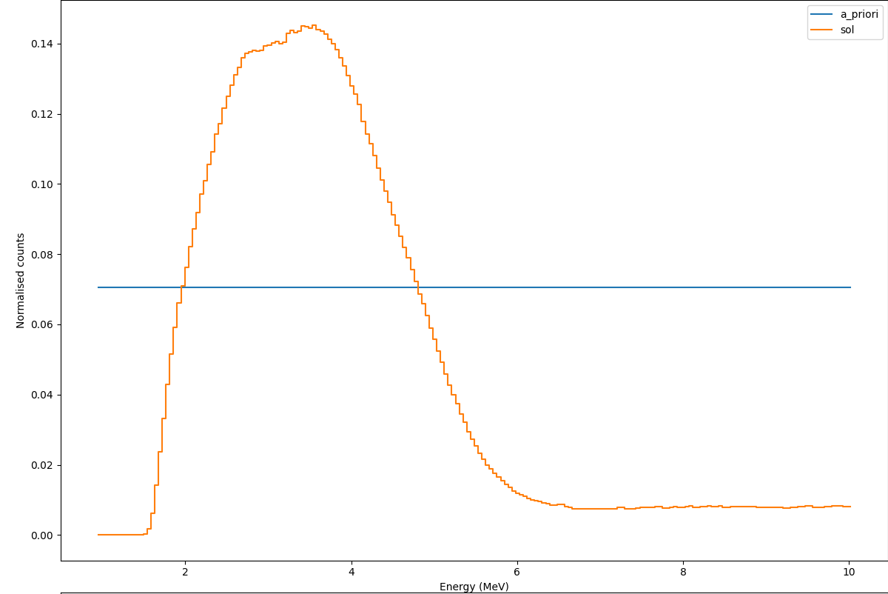
Neutron Unfolding, GRAVEL Results
Initial Guess = np.ones(), $\text{Δ}{\text{J}}_{\text{stop}}=0.2$
1.
2.
Ran for 48 iterations
Ran for 20 iterations
The development, testing and comparison of unfolding methods in SPECTRA-UF for neutron spectrometry – ScienceDirect (2020)

Slide 14
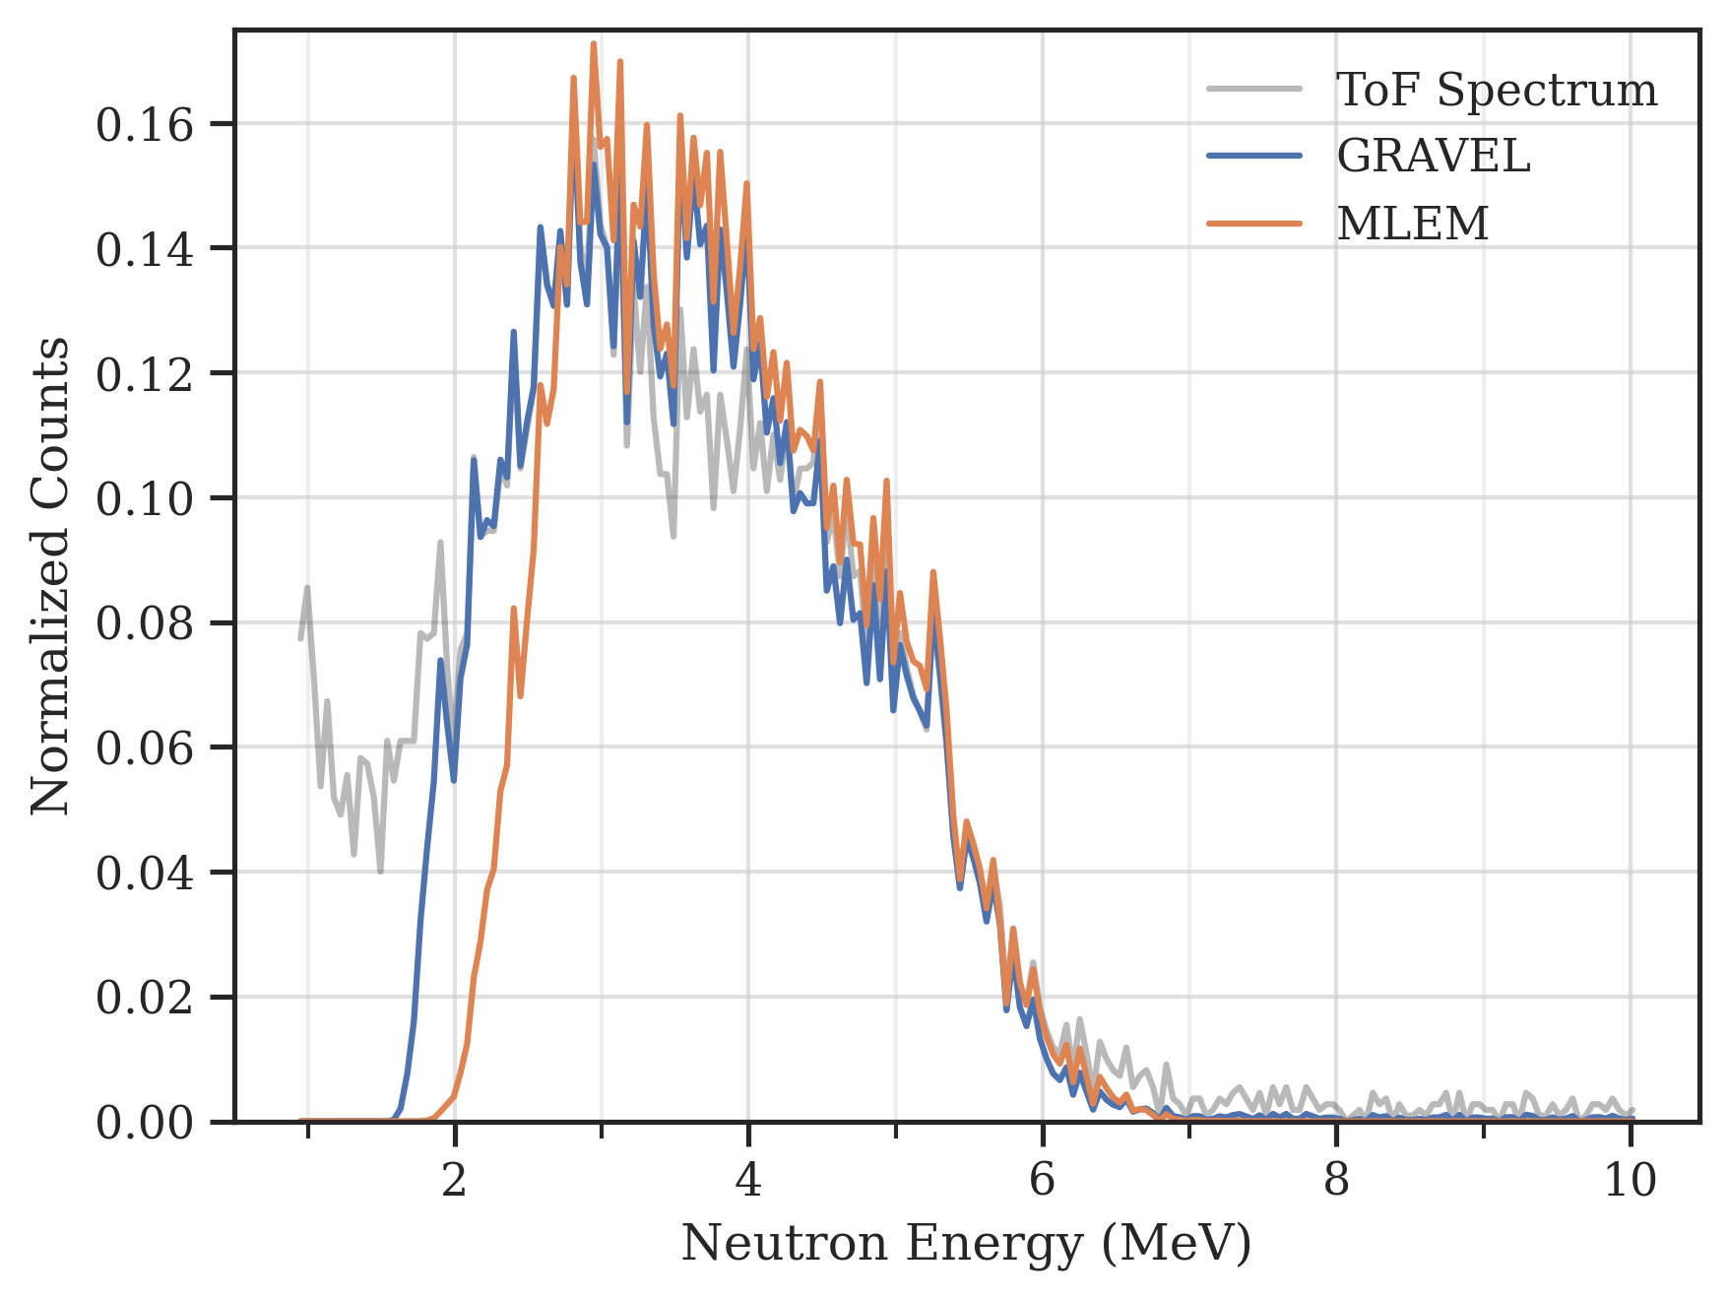
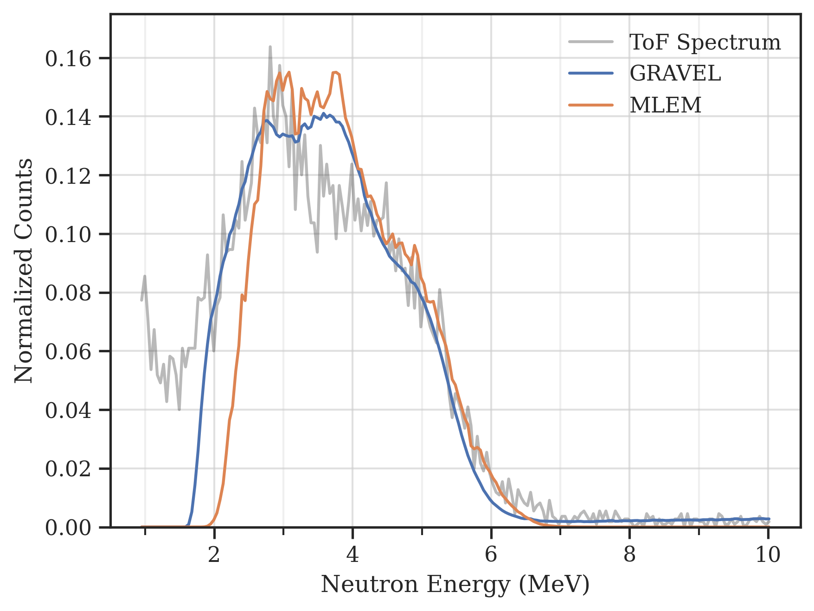
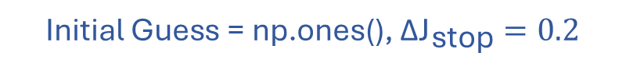
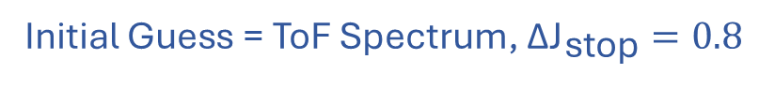
Neutron Unfolding, MLEM Results
Initial Guess = ToF Spectrum, $\text{Δ}{\text{J}}_{\text{stop}}=0.8$
Initial Guess = np.ones(), $\text{Δ}{\text{J}}_{\text{stop}}=0.2$
1.
2.

Slide 15
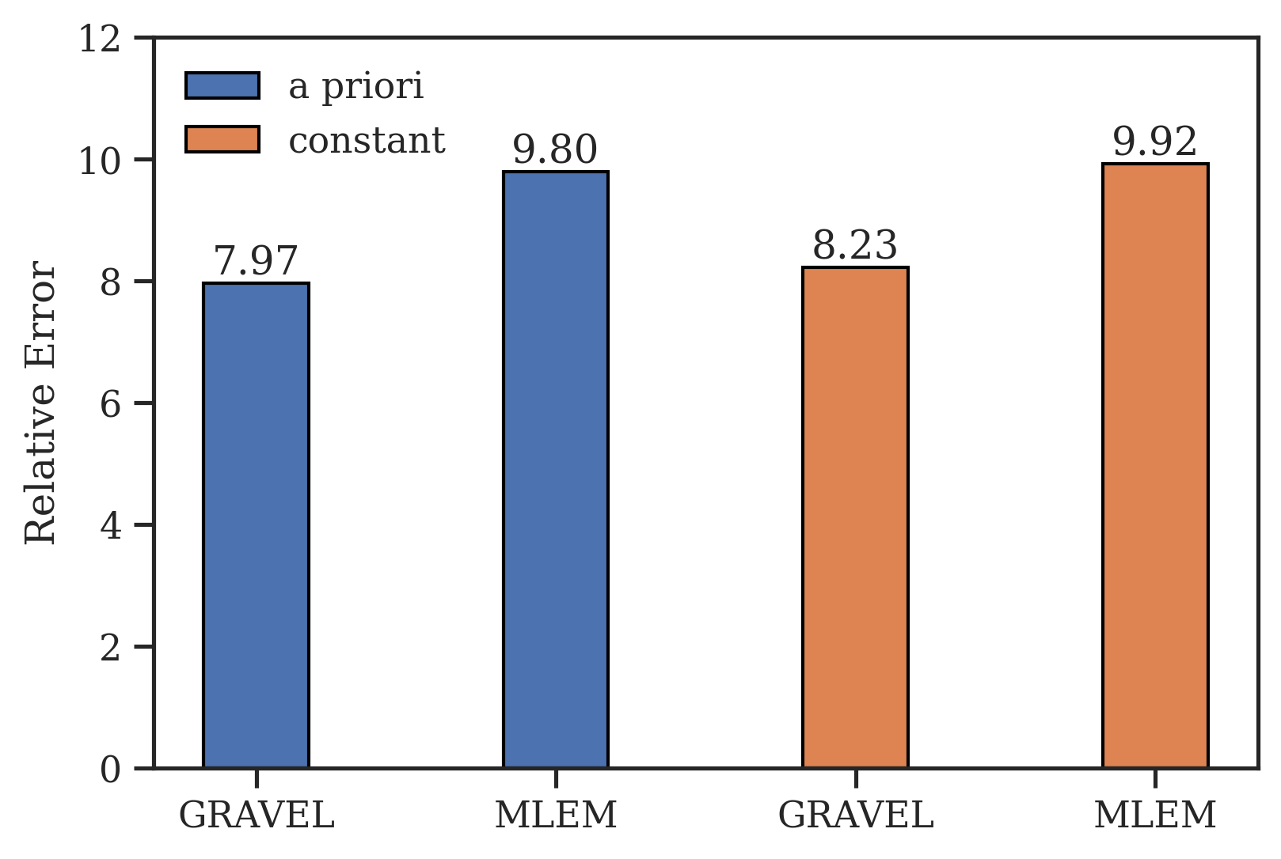
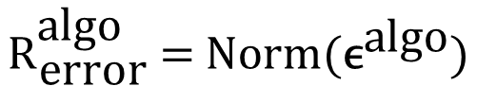
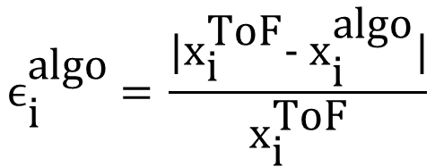
Neutron Unfolding, Comparison
$${\text{ϵ}}_{\text{i}}^{\text{algo}}\text{ = }\frac{\text{|}{\text{x}}_{\text{i}}^{\text{ToF}}\text{− }{\text{x}}_{\text{i}}^{\text{algo}}\text{|}}{{\text{x}}_{\text{i}}^{\text{ToF}}}$$
$${\text{R}}_{\text{error}}^{\text{algo}}\text{ = }\text{N}\text{orm}\text{(}{\text{ϵ}}^{\text{algo}}\text{)}$$

Slide 16
Summary
Time of Flight Experiment
Gamma and AmBe Data Collection
Neutron Unfolding Algorithms
GRAVEL
MLEM

Slide 17
Open Discussion
tylerdolezal/Neutron-Unfolding: Python implementations of GRAVEL and MLEM algorithims are available within (github.com)

